Slide 1
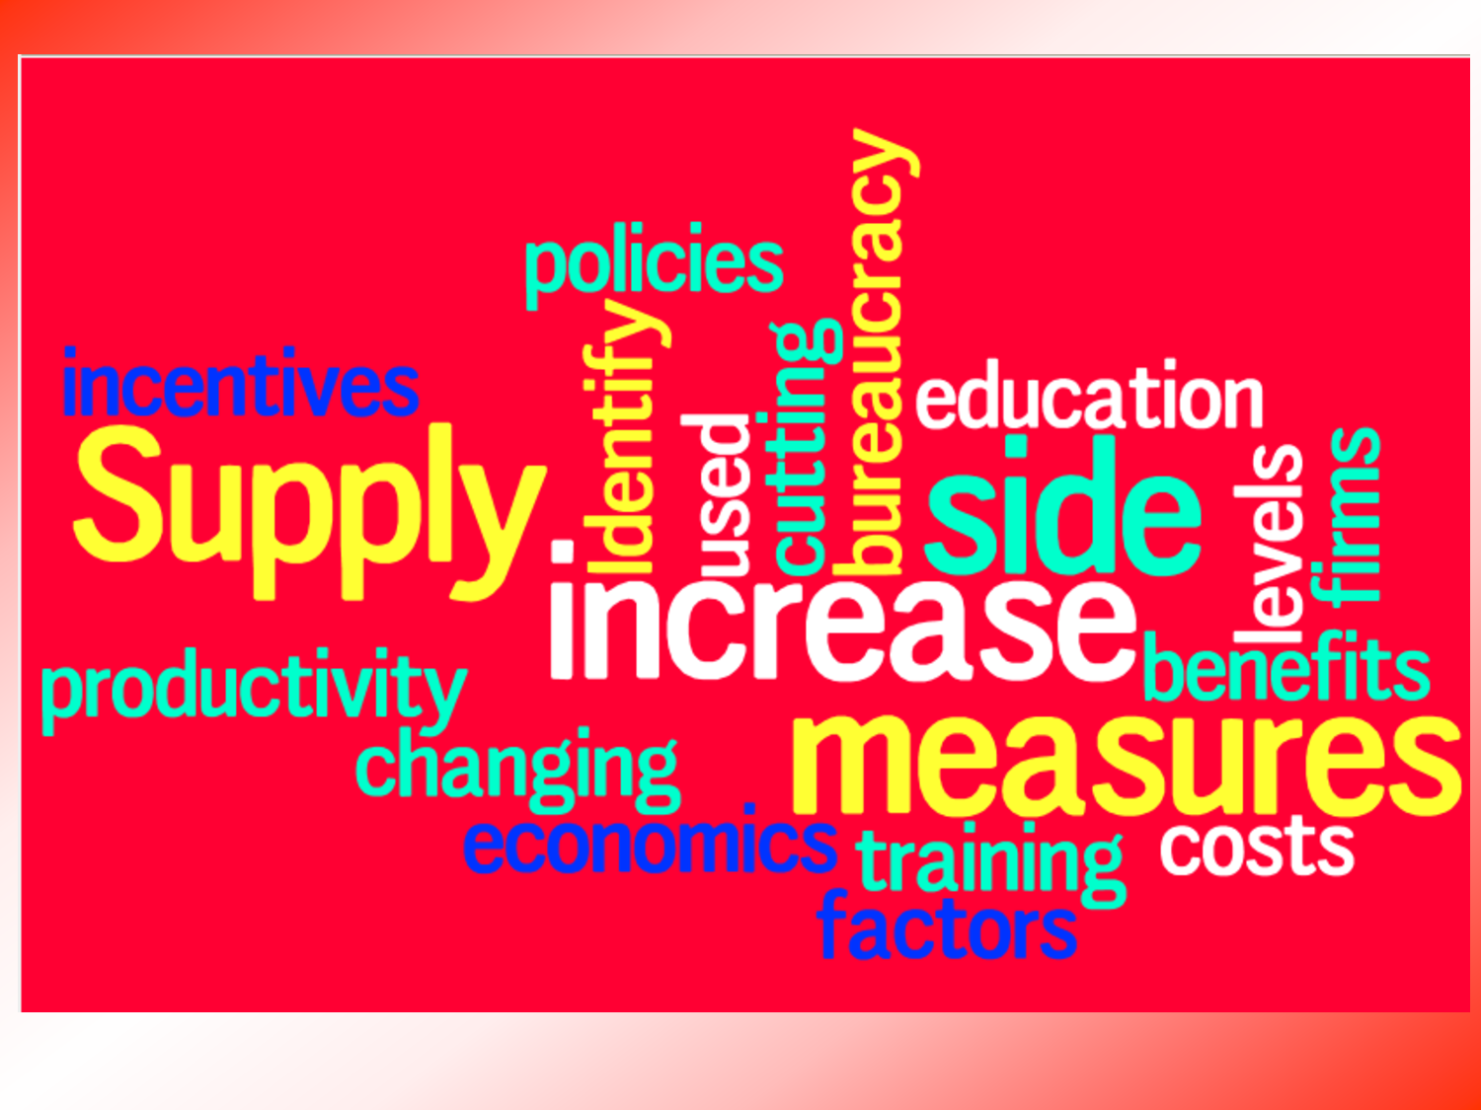
Supply-side policies
Chapter 19

Slide 2
Supply-side policies
Are a combination of government-led and free market policies designed to increase the productive capacity of the country.
Aim at positively affecting the production side of an economy by improving the institutional framework and the capacity to produce – changing the quantity and/or quality of factors of production.

Slide 3
Increase in full-employment and output
LRAS
SRAS
LRAS₁
SRAS₁
PL
AD₁
AD
Y_{FE}
Y_{FE1}
Real GDP

Slide 4
Increase in short run as
LRAS
SRAS
PL
SRAS₁
AD
Y_{E}
Y_{FE}
Real GDP

Slide 5
Increase in ad vs. as
LRAS
SRAS
PL
SRAS₁
P₁
P_{E}
AD₁
AD
Y_{E}
Y_{FE}
Real GDP
Notes:
Inflation: demand pull and cost push
Deflation: demand deficient and supply-side

Slide 6
MARKET-BASED SUPPLY-SIDE POLICY
These are policies implemented by government, aimed at encouraging production and consumption by the free-market and thus stimulating economic activity without increased government intervention.
Policies include:
Policies to encourage competition
Labor market reforms
Incentive-related policies

Slide 7
MARKET-BASED SUPPLY-SIDE POLICY: Policies to encourage competition
DEREGULATION OF INDUSTRY:
Leads to lower costs among producers, encouraging producers to increase their output, hire more workers, charge lower prices for their goods.
ANTI-MONOPOLY REGULATION
Prevents or dismantle monopolies in the market, increase choices for consumers and decrease in prices
PRIVATIZATION
Increase competition and efficiency, lower costs and increase employment
TRADE LIBERALIZATION (FREE TRADE)
Encourage free trade, reduction of trade barriers and open competition (opposed tariffs, quotas and subsidies)

Slide 8
MARKET-BASED SUPPLY-SIDE POLICY: labor market reforms
REDUCING TRADE UNION POWER
Restricting trade union power decreases wage-setting power; more workers would move freely among employers and more employment
REDUCING UNEMPLOYMENT BENEFITS
Increase incentive to find employment
ENDING THE MINIMUM WAGE
Increase wage competition among workers, and encourage more workers to take jobs at lower wages

Slide 9
MARKET-BASED SUPPLY-SIDE POLICY: INCENTIVE-RELATED POLICIES
REDUCING INCOME TAX
Increases incentive to work
REDUCING BUSINESS TAXES AND CAPITAL GAINS TAXES
Encourages firms to produce more and encouraging more employment; encourage investments

Slide 10
Interventionist SUPPLY-SIDE POLICY
Policies that involve a greater role of government but lead to a greater productivity or lower costs, encouraging a higher level of production and economic growth and employment.
Policies include:
Investment in human capital
Investment in new technology
Investment in infrastructure
Industrial policies

Slide 11
interventionist SUPPLY-SIDE POLICY: investment in human capital
EDUCATION
Education improves the skills and productivity of the workforce. High level of educational achievement are highly correlated with national income.
TRAINING
Helps businesses find productive employees and thus should enhance economic growth
HEALTH SERVICES
Can improve labor productivity
Notes:
In the SR will move AD, but in the LR, this will increase the LRAS

Slide 12
interventionist SUPPLY-SIDE POLICY: investment in new technology
INVESTMENT BY GOVERNMENT IN RESEARCH AND DEVELOPMENT
Research funded by government agencies can lead to scientific breakthroughs that ultimately increase efficiency and productivity in the private sector
Policies that encourage R&D have an immediate impact on AD but could increase LRAS
Government spending stimulates AD in the immediate term; but if the R&D results in new life-enhancing drugs, increased food production, and safer or cleaner technologies, the entire productive capacity is enriched, pushing LRAS outwards

Slide 13
interventionist SUPPLY-SIDE POLICY: investment in infrastructure
INFRASTRUCTURE
Is the building of large-scale public projects such as ports, highway systems, bridges, communication networks, as well as power and water systems
This increases AD in the short run, but should also expand the capital base of the country in the long term
Imports and exports of goods will be improved

Slide 14
interventionist SUPPLY-SIDE POLICY: industrial policies
FINANCIAL INCENTIVES
The gov’t. can support the industry with reduced taxes, subsidized loans, and even direct subsidies
These all reduce the costs to the firms, and encourage more production
PROTECTION FOR ‘INFANT INDUSTRIES’
Government can put down protective tariffs or quotas to keep foreign competition out until the firm is sufficiently large and developed

Slide 15
Evaluation of supply-side policies
Time lags: Supply side policies generally take time to implement and show results in the long run. For example, improving the quality of human capital, through education and training, is unlikely to yield quick results.
These policies have an ability to create employment as more jobs are created in various fields such as education, technology and health care. Moreover, these jobs are long term and sustainable.
Supply side policies have the ability to reduce inflationary pressure in the long term because of efficiency and productivity gains in the product and labor markets.

Slide 16
Evaluation of supply-side policies
Supply-side policy is very costly to implement and have severe impact on the government budget. For example, the provision of education and training is highly labor intensive and extremely costly. The government has to carefully plan these spending over a period of time.
In the short run market oriented supply side policies such as reducing in income and corporate taxes can reduce government’s main source of revenue, however in the long run size of the economic growth would be significant enough that the increased government revenue from a faster growing economy would cause overall revenue to increase.

Slide 17
Evaluation of supply-side policies
Effect on equity: Many supply-side measures have a negative effect on the distribution of income, at least in the short-term. For example, lower taxes rates, reduced union power, and privatization have all contributed to a widening of the gap between rich and poor.
Effect on the environment: Supply side policies lead to more economic growth. However, it can lead to exploitation of natural resources and environment if environmental regulations are relaxed thus creating negative externalities of production.
Opposition: Power of labor unions, reducing unemployment benefits and abolishing minimum wages can lead to wide spread discontent among the labor force in the economy. Thus governments are usually hesitant in taking these steps. Moreover, these might also lead to worsening of working conditions in the long run which will affect labor productivity.

