Slide 1
Macroeconomic Objective: Equity in Income Distribution
Chapter 16

Slide 2
Equality vs. Equity in the distribution of income
Equity refers to the fairness in economics, while equality means minimizing the disparities in income and wealth among a nation’s households.
Equity requires a level playing field on which individuals in society can all have a fair shot at achieving economic success.
Equity ultimately promotes greater equality in income distribution.

Slide 3
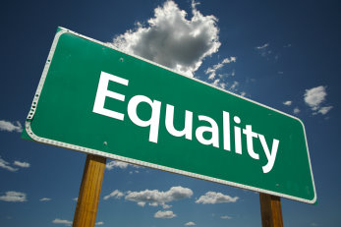
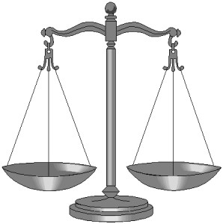
Minimizing disparities
Fairness

Slide 4
Wealth inequality
http://www.youtube.com/watch?v=QPKKQnijnsM
Notes:
http://www.youtube.com/watch?v=QPKKQnijnsM

Slide 5
Unequal distribution
One of the characteristics of a free market is unequal distribution of income
Some people will earn more than others and therefore be in a position to consume/demand more
There is an argument to say that large inequalities are unfair
People on low incomes will experience relatively low living standards and will have fewer opportunities
In developing countries they may live in relative poverty

Slide 6
Economic incentives
Unequal distribution of income is seen as unfair…but
People need an incentive to work hard
They will work harder to gain higher incomes
If the incentive was not there people may not work hard in school and in work
Human capital would not improve having huge implications on the supply side of the economy
How much inequality is allowed is a value/normative judgement
Governments try to bring about equity rather than equality so that they do not destroy the incentive to work harder

Slide 7
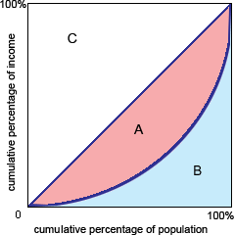
Measuring the distribution of income
A method of measuring and illustrating the degree of inequality in the distribution of income and wealth is the LORENZ CURVE
Horizontal axis measures the
cumulative percentage of the
Population
Vertical axis measures
percentage of income
The 45 degree line is the line
of perfect equality (50% of the
population would have 50%
of the income)
The actual share of income is
shown by the curve (the Lorenz curve))
The greater the degree of inequality
the further the curve will be from the
45 degree line

Slide 9
Measuring the distribution of income
A statistical measure of the degree of inequality shown on a Lorenz curve is known as the GINI COEFFICIENT
It is the ratio of the area between the line and the curve and the total area beneath
the 45 degree line [a / (a+b)]
Perfect equality would give a
ratio of zero and perfect
inequality would give 1
The closer to 1 the more unequal
the distribution of income

Slide 10
Gini Index
Is an economic indicator of the level of income distribution in a nation
It is expressed as a number between 0 and 100 (Gini coefficient times 100)
The closer the index to 100, the greater the disparity between the richest and poorest households in a nation
The closer to zero, the more equally income is distributed across the nation’s households

Slide 11
Gini coefficient data for the UK
Year | Gross Income | Disposable Income
1980 | 0.34 | 0.28
1990 | 0.38 | 0.36
2003 | 0.37 | 0.33
The table shows Gini coefficient data for the UK from 1980 to 2003 for both gross income and disposable income
Gross income is before tax
Disposable income is what you are left with to spend
What do the numbers show?
Tax reduces Gini coefficient – makes income distribution more equitable
In 1980, tax helped reduce the inequality more than in 1990 and 2003

Slide 12
Ted Talk: “Rich people don’t create jobs”
http://www.youtube.com/watch?v=iIhOXCgSunc
Notes:
http://www.youtube.com/watch?v=iIhOXCgSunc

Slide 13
How economic inequality harms society
http://www.youtube.com/watch?v=AFOEe6M2VT4
Notes:
http://www.youtube.com/watch?v=AFOEe6M2VT4

Slide 14
Indicators of poverty
What does it mean to be poor?
Poverty exists everywhere
Higher-income contries => relative poverty
Poorest countries => absolute poverty

Slide 15
Relative vs. Absolute Poverty
Relative Poverty
condition experienced by people in a country whose incomes are considerably lower than the higher income groups in the same country
it exists even in the world’s richest countries
Absolute Poverty
condition experienced by individuals who cannot afford to acquire the basic necessities for a healthy and safe existence
Does not exist everywhere, it is primarily concentrated across the 60% poorest countries of the world
Notes:
America – poor if earning less than $10,830/year for single; or $22k/year for family of four
India – poor if less than 500 rupees per month ($140/year)

Slide 16
Possible Causes of Poverty
Low income
Unemployment
Lack of human capital

Slide 17
Reasons for low income
Incomes may be low and people may live in poverty because….
They were born into a household where income is low
They may have received poor, or no education
They may have had poor health care and malnutrition
They may have had to go out to work before completing an education
The consequence of poverty include
Low living standards
Lack of access to sufficient health care
Low levels of education
The consequences lead to low levels of human capital
If people have poor education and health care, they will find it difficult to find work or it may be low paid

Slide 18
Evaluation
It is important to be careful when using the Gini index numbers to evaluate a country’s development progress
Although low income countries tend to have higher levels of inequality than high income countries there is no hard and fast correlation between the level of development and its Gini index
It is also not correct to assume that having more equality will raise living standards
If poorest 20% of the population earns 3% of the national income and the national income rises and the income distribution remains the same – the poorest will receive a larger amount (the cake got bigger but their percentage share remained)
Notes:
The Human Development Index (HDI) is a composite statistic of life expectancy, education, and income indices to rank countries into four tiers of human development.

Slide 19
Improving inequality of income with taxation
Tax can be used to improve income inequality
There are 2 different types of tax
DIRECT taxes
INDIRECT taxes

Slide 20
Direct Taxes
Taxes imposed on people’s income or wealth and on firm’s profit
Taxes that are paid directly to the government by those on whom they are imposed
Example: Income tax and Corporation tax
Unavoidable because individuals and firms have to declare their full income

Slide 21
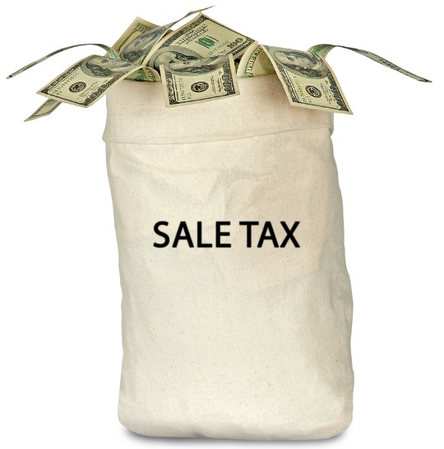
Indirect Taxes
Taxes paid by households through an intermediary such as a retail store
The intermediary then pays the government
Possibly avoidable – you can choose not to buy the goods and services
Notes:
A value added tax (VAT) is a form of consumption tax. It differs from the sales tax in that, with the latter, the tax is collected and remitted to the government only once, at the point of purchase by the end consumer. With the VAT, collections, remittances to the government, and credits for taxes already paid occur each time a business in the supply chain purchases products.
Excise Tax – taxes on specific goods such as cigarettes, alcohol or petrol

Slide 22
Types of Taxation Systems
Proportional Tax
Regressive Tax
Progressive Tax

Slide 23
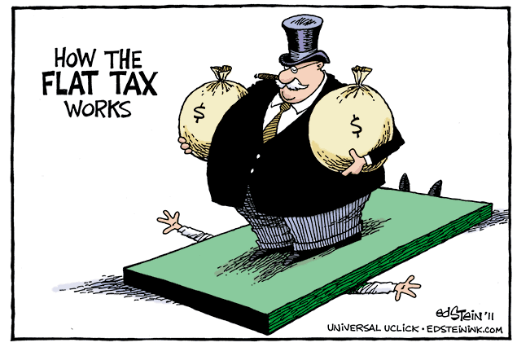
Proportional Tax
A tax for which the percentage remains constant as income increases
Many countries are now promoting the idea of proportional direct taxes or flat taxes
The same percentage tax is paid at all levels of income

Slide 24
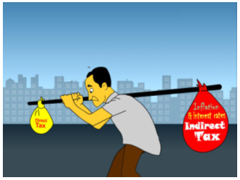
Regressive Tax
Tax that decreases in percentage as income increases
Such a tax places a larger burden on lower income household than it does on higher income earners since a greater percentage of a poor household’s income is used to pay the tax than a rich household’s
Most indirect taxes are regressive

Slide 25
Regressive Tax
Income of buyer $ | Amount of tax paid $ | % of income taxed
10,000 | 100 | 1%
50,000 | 100 | 0.2%
100,000 | 100 | 0.1%
The higher-income consumer pays the same amount of tax as the lower-income consumer
Although they appear to be equitable since everyone pays the same percentage of the price of the goods they consume, placing a larger burden on those whose ability to pay is lower and a smaller burden on the higher-income earners whose ability to pay is greater
Regressive taxes may be a good source of government revenue and might discourage the consumption of demerit goods but they can worsen income inequality

Slide 26
Progressive Tax
This is a tax for which the percentage paid in tax increases as income increases
Is the most equitable of the 3 types of taxes a government collects
Lower income households not only pay less tax, but they pay a smaller percentage of their income in tax as well
This is a hypothetical example where there are 4 tax brackets
Taxable Income ($) | % to be paid as tax
0 – 10,000 | 0
10,001 – 25,000 | 30%
25,001 – 50,000 | 40%
50,001 and higher | 50%

Slide 27
Progressive Tax
If someone earns $56,000 they will pay the following tax:
For the first $10,000 = 0
For the next $15,000 = 4.5k (15k x .30)
For the next $25,000 = 10k (25k x .40)
For the next $6,000 = 3k (6k x .50)
In total they would pay = 17,500
On average they would be paying 31% tax (17,500 / 56,000)

Slide 28
Progressive Taxation Exercise
How much tax would they pay and what is their average tax rate if they earned:
$7,000
$14,000
$28,000
$77,000
Taxable Income ($) | % to be paid as tax
0 – 10,000 | 0
10,001 – 25,000 | 30%
25,001 – 50,000 | 40%
50,001 and higher | 50%

Slide 29
Tax Calculation – HL only
There are 2 types of calculations you could be asked to perform
The average tax rate = total tax paid divided by income x 100
The marginal tax rate = change in total tax paid divided by change in income x 100

Slide 30
Progressive Taxation Exercise
A person earning $56k paid an average tax rate of 31%
If the same person’s salary went up to $63k the total tax paid would be = 0 + 4.5 + 10 + 6.5 = $21k
Originally they paid $17.5k
The marginal tax rate = (21 – 17.5) / (63 – 56) = 50%
Taxable Income ($) | % to be paid as tax
0 – 10,000 | 0
10,001 – 25,000 | 30%
25,001 – 50,000 | 40%
50,001 and higher | 50%

Slide 31
Progressive Tax
Arguments for a progressive income tax
Provides governments with an effective means of redistributing the nation’s income because those with the greatest ability to pay (the rich) provide the nation with far more of its revenue than those with the least ability to pay (the poor).
Arguments against progressive income tax
Further increases in the tax rate are believed to lead to a decline in the amount of taxable income due to the disincentive created by the higher tax rate.

Slide 32
Comparing Income Tax Systems

Slide 33
Other measures to promote equality
Role of government: provision of public goods
Government provides education and health
Role of government: transfer payments
Unemployment benefits
Social security benefits
Nutritional subsidies
Higher education grants and tuition subsidies
Welfare benefits

