Slide 1
Monetary Policy
Unit 2.5

Slide 2
What is money?
Money is any object or record that is widely accepted as payment for goods and services.
3 Functions:
Money must be a medium of exchange
Money must serve as a unit of account
Money must be a store of value

Slide 3
Categories of Money
M1
All currency (paper and coin money)
Deposits, traveller’s checks
M2
All of M1
Less accessible money such as time deposits and short-term deposits

Slide 4
Online Videos
What is Money? http://www.youtube.com/watch?v=DjTs-rjVkB8&list=PLF2A3693D8481F442
Creating Money http://www.youtube.com/watch?v=pZRvja7Mvrw&list=PLF2A3693D8481F442
The Fed http://www.youtube.com/watch?v=aMg3vrQ6keE&list=PLF2A3693D8481F442

Slide 5
Intro to Money Market
Macroeconomics policymakers have 2 general tools to manage the level of aggregate demand
Fiscal Policy – changing the levels of taxes and government spending
Monetary Policy – changing the supply of money available in a nation
Carried out by the central bank of each country
Note the difference between central bank and commercial bank

Slide 6
Central bank vs. Commercial bank
Commercial banks
are financial institutions whose main functions are
to hold deposits for their customers (consumers and firms)
to make loans to their customers
to transfer funds by check & electronically from one bank to another
to buy government bonds

Slide 7
Role of Central Banks
Central bank
Is the monetary authority of a country, which performs the functions of issuing currency, managing the money supply, and controlling interest rates
2 largest economies
European Union – The European Central Bank (ECB)
United States – US Federal Reserve (the Fed)
Independent from politics
Head and governors are appointed by politicians to fixed terms
Notes:
ECB – based in Frankfurt Germany
Fed – based in Washington DC
South Korea – Bank of Korea (Seoul)
Fed – Governors serve 14 years; chairman 4 year term (renewable) – Alan Greenspan served >18 years; current Ben Bernake (on his 2nd term)
Other central banks: Bank of England, the Bank of Japan, People’s Republic of China, Swiss National Bank

Slide 8
Central Bank’s Responsibilities
Banker to the government
Banker to commercial banks
Regulator of commercial banks
Conduct Monetary Policy

Slide 9
Central Bank’s Responsibilities
Banker to the government
Holds the government’s cash/deposits
Receives payments for the gov’t and makes payments for the gov’t
Manages the government’s borrowing by selling bonds to commercial banks and the public
Acts as an adviser to the gov’t on financial and banking matters

Slide 10
Central Bank’s Responsibilities
Banker to commercial banks
Holds deposits for commercial banks
Loans to commercial banks in times of need
Note: central bank does not act as a banker to consumers and firms

Slide 11
Central Bank’s Responsibilities
Regulator of commercial banks
Central bank regulates and supervises commercial banks, making sure they operate with appropriate levels of cash & according to rules that ensure the safety of the financial system
This is a very important function, because the funds that commercial banks use to make loans are the savings and other deposits that consumers and firms deposit with commercial banks

Slide 12
Central Bank’s Responsibilities
Conduct Monetary Policy
CB is responsible for monetary policy, based on changes in the supply of money or the rate of interest
Usually responsible for the determination of exchange rates because of the close relationship between interest rates and exchange rates

Slide 14
The Money Market
Money Demand
Includes the desire to hold money as an asset and the demand for money as a means to purchase goods and services
Inversely related to the interest rate
Increases / decreases with the overall level of national output
Money Supply
Is determined by the action of the central bank aimed at increasing or decreasing the overall supply of money available in a nation

Slide 15
Equilibrium in the Money Market
Interest
Rate
Money
Supply (Sm)
r₁
Equilibrium
interest
rate
r₂
Money
Demand (Dm)
0
d
d
Quantity of
M
Quantity fixed
M₂
by the Central Bank
Money
Notes:
Sm is inelastic because the central bank has the authority to set the level of the money supply. It operates independently of the interest rate. It doesn’t depend on the rate of the interest rate.
Dm – positively influenced by increased real income and increased inflation; but has a negative relationship with interest rates

Slide 16
Monetary Policy and the Money Market
Money Market
Loanable Funds Market
Interest Rate
Interest Rate
M₀
M₁
S₀
… an increase in loanable funds
Expansionary monetary policy leads to…
S₁
i₀
i₀
i₁
i₁
D
D
Q of Money
Q of Loanable Funds
The decline in interest rates increases investment spending, which shifts the aggregate demand curve out to the right
14-16

Slide 17
Monetary Policy
Price level
Monetary policy affects both real output and the price level
Expansionary monetary policy shifts the
AD curve to the right
SAS
P₁
P₀
AD₁
Contractionary monetary policy shifts the AD curve to the left
P₂
AD₀
AD₂
Y₂
Y₀
Y₁
Real output
14-17

Slide 18
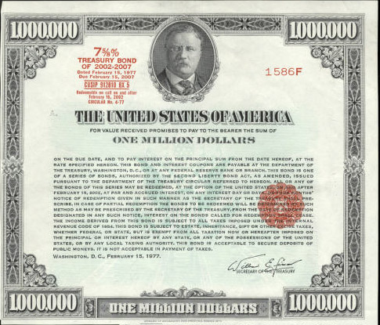
Tools for changing the money supply
Central banks manage the money supply with the following monetary policy tools:
Changing the discount rate
Buying or selling bonds
Changing the reserve requirement

Slide 19
Tools for changing the money supply
(1) Changing the discount rate
Discount rate is the rate charged by central banks when they make loans to big commercial banks
Central bank is typically the “lender of last resort”; commercial banks would try to borrow first from other commercial banks
Lower discount rate, increases money supply and lowering interest rates across the economy

Slide 20
Tools for changing the money supply
(2) Buying and selling bonds (Open Market Operations – OMO)
Central bank buys bonds from private banks
Puts cash into banks’ reserves, increasing the funds available for banks to make loans
Incentive for banks to lower the interest rates they charge private borrowers
Increases the level of consumptions and investment in the economy – Expansionary monetary policy
Central bank sells bonds to private banks
Commercials banks’ reserves are taken out of the private banking system
Less money available for loans which increases interest rates
Decreases the level of consumption and investment in the economy – contractionary monetary policy
Notes:
Buy bonds: Bank’s reserves, interest rates, consumption and investment (which policy)

Slide 21
Tools for changing the money supply
(3) Changing the reserve requirement
Reserve requirement is the % of deposits that banks are required to have available at all times
Amount held beyond the reserve requirement is called excess reserves
If the reserve requirement is lowered, bank will have more money to loan out. This increases money supply and lowers interest rate.

Slide 22
Tools for changing the money supply
Additional info:
http://www.investopedia.com/ask/answers/07/central-banks.asp

Slide 23
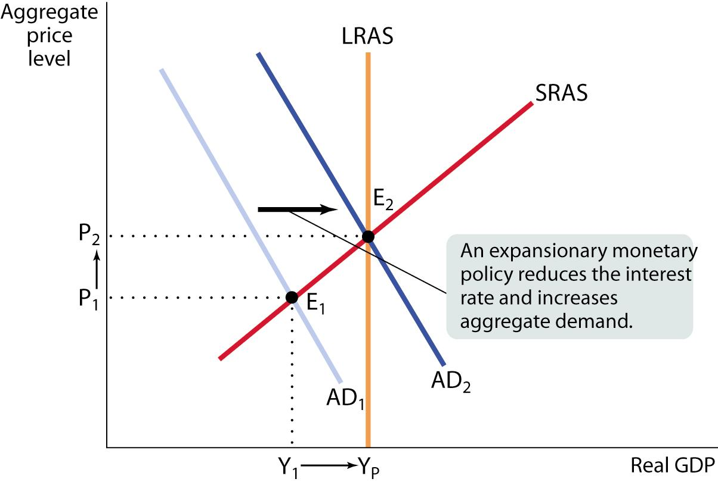
Expansionary Monetary Policy to Fight a Recessionary Gap
Notes:
Here, initial actual aggregate output, Y₁, is below potential output, Y_{E}. An expansionary monetary policy reduces the interest rate, shifting the aggregate demand curve rightward from AD₁ to AD₂ and eliminating the recessionary gap.
Expansionary Monetary Policy = lower the discount rate; buy bonds on the open market; lower the reserve ratio

Slide 24
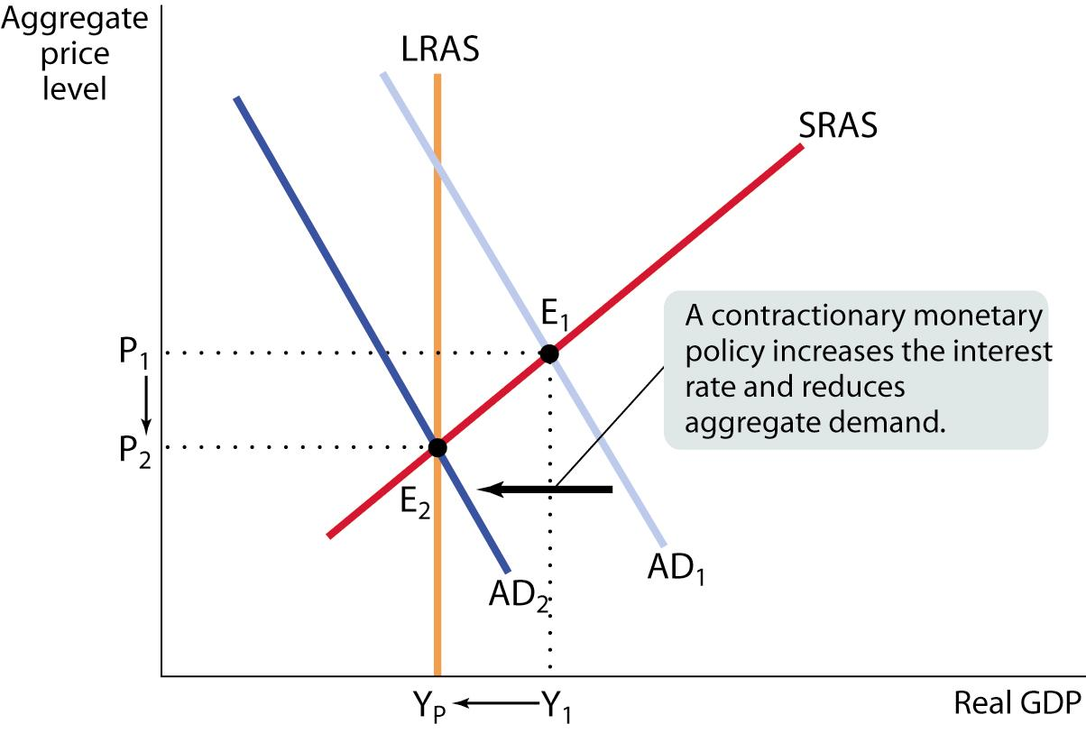
Contractionary Monetary Policy to Fight an Inflationary Gap
Notes:
Here, initial actual aggregate output, Y1, is above potential output, YE. A contractionary monetary policy increases the interest rate, shifting the aggregate demand curve leftward from AD1 to AD2 and eliminating the inflationary gap.
Contractionary Monetary Policy = raise the discount rate; sell bonds on the open market; raise the reserve ratio

Slide 25
Monetary Policy
Expansionary monetary policy is a policy that increases the money supply and decreases the interest rate and it tends to increase both investment and output
Contractionary monetary policy is a policy that decreases the money supply and increases the interest rate, and it tends to decrease both investment and output
M
i
I
Y
M
i
I
Y
14-25

Slide 26
Online tools
Welker’s Wikinomics http://www.econclassroom.com/?cat=19

Slide 27
Evaluation of Monetary Policy

Slide 28
Stimulating growth during recession
STRENGTHS
Speed
Control
No Politics
No crowding-out

Slide 29
Stimulating growth during recession
STRENGTHS
Speed
Can be enacted by the CB as soon as the problem is recognized
CB skips the process by which legislators debate fiscal policy and create compromises in order to get the policy passed

Slide 30
Stimulating growth during recession
STRENGTHS
Control
It is within the power of the CB to adjust the money supply more discretely and finely than legislators can with fiscal policy

Slide 31
Stimulating growth during recession
STRENGTHS
No Politics
CB is independent of politics and not involved in election processes
This should prevent the desires of voters from influencing CB policy

Slide 32
Stimulating growth during recession
STRENGTHS
No Crowding-Out
Monitary policy, by lowering interest rates, avoids crowding-out

Slide 33
Stimulating growth during recession
WEAKNESSES
Investors reluctant to borrow
Time lags
Changes in elasticity of demand for investment

Slide 34
Inflation Control
STRENGTHS
Direct action, speed and control
Apolitical nature of the bank

Slide 35
Inflation Control
WEAKNESSES
Time lags during high inflation
Ineffective against cost-push inflation

Slide 36
Test your understanding
Explain the functions of central banks and their role with respect to achieving macroeconomic objectives.
Explain the importance of the money supply in determining the rate of interest.
What is the government authority that is responsible for changing the supply of money and carrying out monetary policy?
Using a diagram, explain how equilibrium interest rates are determined.
What would a central bank do if it wanted to (i) lower interest rates, (ii) to increase interest rates?

Slide 37
Test your understanding
What are the objectives of monetary policy?
Distinguish between expansionary and expansionary monetary policy.
What are the components of AD that the monetary policy can influence?
Using diagrams, show how the government can use monetary policy when there is (a) a recessionary gap, and (b) an inflationary gap

