Slide 1
Ch. 7 Costs, Revenues and Profits (HL Only)
IB DP Economics

Slide 2
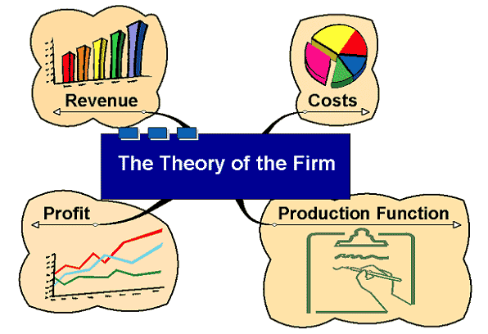
The Theory of the Firm
Notes:
The theory of the firm consists of a number of economic theories that describe, explain, and predict the nature of the firm, company, or corporation, including its existence, behavior, structure, and relationship to the market.

Slide 3
The Theory of the Firm
The theory of the firm consists of a number of economic theories that describe, explain, and predict the nature of the firm, company, or corporation, including its existence, behavior, structure, and relationship to the market.

Slide 4
The Theory of the Firm
Notes:
The theory of the firm consists of a number of economic theories that describe, explain, and predict the nature of the firm, company, or corporation, including its existence, behavior, structure, and relationship to the market.

Slide 5
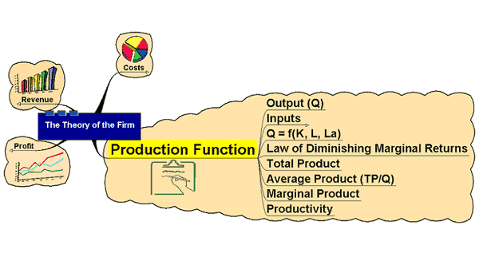
Production Function

Slide 6
Production Function
States the relationship between inputs and outputs
Inputs – the factors of production classified as:
Land – all natural resources of the Price paid to acquire land = Rent
Labor – all physical and mental human effort involved in production
Price paid to labor = Wages
Capital – buildings, machinery and equipment not used for its own sake but for the contribution it makes to production
Price paid for capital = Interest

Slide 7
7.1 Costs of production: economic costs Learning outcomes:
Explain the meaning of economic costs as the opportunity cost of all resources employed by the firm (including entrepreneurship)
Distinguish between explicit costs and implicit costs as the two components of economic costs.

Slide 8
April 20, 2010 Deepwater Horizon
http://www.msnbc.msn.com/id/37279113/ns/nbcnightlynews/t/deepwater-horizon-rig-what-went-wrong/#.ULduC0Jpsy4
The company made a series of money-saving shortcuts that increased the danger of a destructive oil spill in a well….

Slide 9
Maximize Profit
Firms seek to maximize their profits through the production and sale of their various goods & services in the product market
Profit maximization = reducing costs and increasing revenues
Profit = Revenue – Expenses (costs)

Slide 10
COSTS:
Costs in economics are those things that must be given up in order to have something else (opportunity cost)
Explicit Costs – are the monetary payments that firms make to the owners of land, labor and capital (rent, wages, interest)
Implicit Costs – are the opportunity costs faced by a business owner who chooses to use his skills & resources to operate his own enterprise rather than seek employment by someone else (also known as normal profit)

Slide 11
Short run vs. Long run
Short run – is the period of time over which firms cannot acquire land or capital resources to increase or decrease production. At least one factor of production is fixed.
Long run – firms are able to acquire & put into production all factors of production to produce output. All resources are variable.

Slide 12
Short run
In the short run, a firm may alter the amount of labor and raw materials it employs towards its production of output, but not the amount of capital or land.
The short-run costs faced by firms can be either explicit or implicit

Slide 13
Analysis of Production Function: Short Run
In times of rising sales (demand) firms can increase labour and capital but only up to a certain level – they will be limited by the amount of space. In this example, land is the fixed factor which cannot be altered in the short run.

Slide 14
Analysis of Production Function: Short Run
If demand slows down, the firm can reduce its variable factors – in this example it reduces its labour and capital but again, land is the factor which stays fixed.

Slide 15
Analysis of Production Function: Short Run
If demand slows down, the firm can reduce its variable factors – in this example, it reduces its labour and capital but again, land is the factor which stays fixed.

Slide 16
Mnemonic for implicit and explicit costs: WIRP
W – Wages are the monetary payments for labor (explicit)
I – Interest cost for firms’ use of capital (explicit)
R – Rent cost of land resources (explicit)
P – Profit or normal profit; cost an entrepreneur must cover in order to remain in business (implicit)

Slide 17
7.2 Production in the short run:
Law of diminishing marginal returns

Slide 18
Short run example: Krispy Kreme
http://www.youtube.com/watch?v=5BguBfiP5TY
Productivity is defined as the amount of output attributable to a unit of input
Highly productive resources result in lower costs for firms
Firms wishes to maximize the productivity of its resources in order to minimize its costs

Slide 19
Law of diminishing returns
As more and more of a variable resource (typically labor) is added to fixed resources (capital and land), beyond a certain point the productivity of additional units of the variable resource declines.
Because the amount of capital is fixed, more workers find it harder to continually add to the firm’s output, so they become less productive.

Slide 20
Short run production
TP – Total Product (total output per hour)
MP – Marginal Product (change in total product attributable to the last worker hired)
AP – Average Product (output per worker)

Slide 21
SHORT-RUN PRODUCTION
RELATIONSHIPS
Total Product (TP)
Marginal Product (MP)
Change in Total Product
Marginal Product =
Change in Units of Labor
Average Product (AP)
Total Product
Average Product =
Units of Labor

Slide 22
Law of Diminishing Returns
Total Product
Total Product, TP
Increasing
Marginal
Returns
Quantity of Labor
Average Product, AP, and
Marginal Product, MP
Average
Product
Marginal
Product
Quantity of Labor

Slide 23
Law of Diminishing Returns
Total Product
Total Product, TP
Diminishing
Marginal
Returns
Quantity of Labor
Average Product, AP, and
Marginal Product, MP
Average
Product
Marginal
Product
Quantity of Labor

Slide 24
Law of Diminishing Returns
Total Product
Total Product, TP
Negative
Marginal
Returns
Quantity of Labor
Average Product, AP, and
Marginal Product, MP
Average
Product
Marginal
Product
Quantity of Labor

Slide 25
Relationship between MP and TP
MP is the slope of TP
If MP is positive, TP is increasing
If MP is negative, TP is decreasing
If MP is zero, it crosses the x-axis; TP is at its highest output (slope is flat)

Slide 26
Relationship between MP and AP
IF MP > AP, AP increases
IF MP < AP, AP falls
If MP = AP, AP will be at a maximum
NOTE that AP can never cross the horizontal axis and become negative as neither Quantity nor Labor can ever be negative

Slide 27
Relationship between MP and AP
Example:
Think of a student taking a series of tests in economics course. If in the sixth test, the student gains a higher grade than his/her average grade to that point (M>A), then the student’s average will rise. If the student receives a lower grade than his/her average grade to that point (M<A), then the student’s average grade will fall. And if the student receives exactly the same grade as his/her average to that point, the student’s average will not change.

Slide 28
Online Tutorial
Introduction to Production:
http://www.youtube.com/watch?v=MAsGhGkckT8
How to calculate TP, AP, MP
http://www.youtube.com/watch?v=A78lu9JDmgo
Relationship of MP and AP (Calculus)
http://www.youtube.com/watch?v=svHs7NtxZD0

Slide 29
7.3 Cost of Production
From short-run to long-run

Slide 30
Analysing the Production Function: Long Run
The long run is defined as the period of time taken to vary all factors of production
By doing this, the firm is able to increase its total capacity – not just short term capacity
Associated with a change in the scale of production
The period of time varies according to the firm and the industry
In electricity supply, the time taken to build new capacity could be many years; for a market stall holder, the ‘long run’ could be as little as a few weeks or months!

Slide 31
Analysis of Production Function: Long Run
In the long run, the firm can change all its factors of production thus increasing its total capacity. In this example it has doubled its capacity.

Slide 32
Production Function
Mathematical representation of the relationship:
Q = f (K, L, La)
Output (Q) is dependent upon the amount of capital (K), Land (L) and Labour (La) used

Slide 33
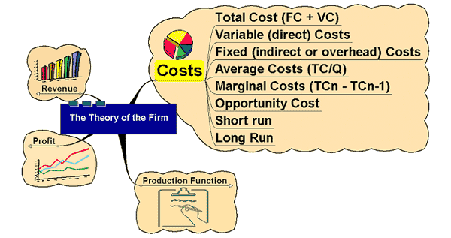
Costs

Slide 34
Costs
In buying factor inputs, the firm will incur costs
Costs are classified as:
Fixed costs – costs that are not related directly to production – rent, rates, insurance costs, admin costs. They can change but not in relation to output
Variable Costs – costs directly related to variations in output. Raw materials primarily

Slide 35
Total Cost - the sum of all costs incurred in production
TC = FC + VC
Average Cost – the cost per unit of output
AC = TC/Output
Marginal Cost – the cost of one more or one fewer units of production
MC = TC_{n} – TC_{n-1} units
Or change in TC / change in Q

Slide 36
Costs
Short run – Diminishing marginal returns results from adding successive quantities of variable factors to a fixed factor
Long run – Increases in capacity can lead to increasing, decreasing or constant returns to scale

Slide 37
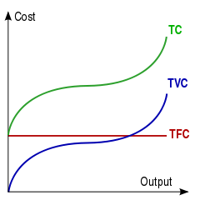

Slide 38
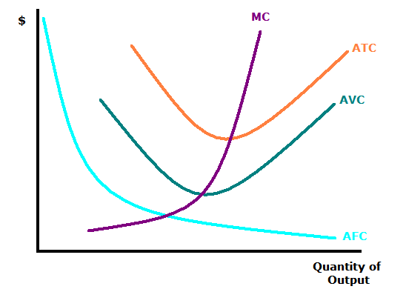

Slide 39
Economies of scale and Diseconomies of scale
Economies of scale – are the advantages that an organization gains due to an increase in size. These will lead to a decrease in the average costs of production.
Diseconomies of scale – are the disadvantages that an organization experiences due to an increase in size. They will increase the average costs per unit.

Slide 40
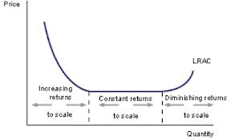
Notes:
Increasing return – also known as economies of scale; as the inputs are increased, output increases proportionally more resulting in average costs falling
Constant returns - as the inputs are increased, output increases by the same proportion resulting in average costs staying constant
Diminishing return – also known as diseconomies of scale; as the inputs are increased, output increases proportionally less resulting in average costs rising

Slide 41
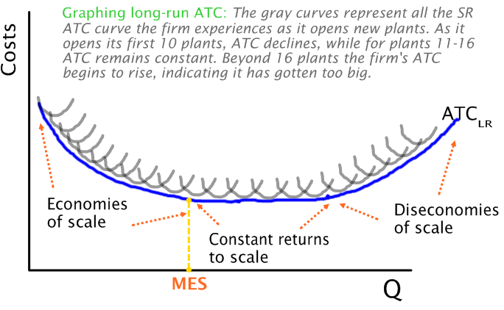
Notes:
MES – Minimum Efficient Scale

Slide 42
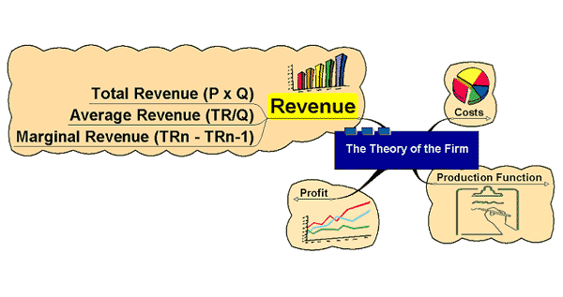
Revenue

Slide 43
Revenue
Total revenue – the total amount received from selling a given output
TR = P x Q
Average Revenue – the average amount received from selling each unit
AR = TR / Q
Marginal revenue – the amount received from selling one extra unit of output
MR = TR_{n} – TR _{n-1} units

Slide 44
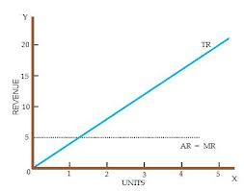
Perfectly Competitive Market

Slide 45
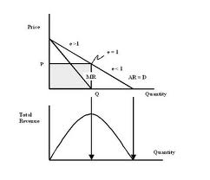
Imperfectly Competitive Market

Slide 47
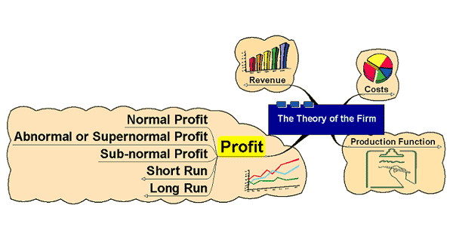
Profit

Slide 48
Profit = TR – TC
The reward for enterprise
Profits help in the process of directing resources to alternative uses in free markets
Relating price to costs helps a firm to assess profitability in production

Slide 49
Accounting vs. Economic Costs
http://www.youtube.com/watch?v=FgttpKZZz7o&list=PL336C870BEAD3B58B&index=24

Slide 50
Normal Profit – the minimum amount required to keep a firm in its current line of production
Abnormal or Supernormal profit – profit made over and above normal profit
Abnormal profit may exist in situations where firms have market power
Abnormal profits may indicate the existence of welfare losses

Slide 51
Sub-normal Profit – profit below normal profit
Firms may not exit the market even if sub-normal profits made if they are able to cover variable costs
Cost of exit may be high
Sub-normal profit may be temporary (or perceived as such!)

Slide 52
Profit
Assumption that firms aim to maximise profit
Profit maximising output would be where MC = MR

Slide 53
If the firm were to produce the 104th unit, this last unit would cost more to produce than it earns in revenue (-105) this would reduce total profit and so would not be worth producing.
The profit maximising output is where MR = MC
Cost/Revenue
Assume output is at 100 units. The MC of producing the 100th unit is 20.
The MR received from selling that 100th unit is 150. The firm can add the difference of the cost and the revenue received from that 100th unit to profit (130)
The process continues for each successive unit produced. Provided the MC is less than the MR it will be worth expanding output as the difference between the two is ADDED to total profit
MC
If the firm decides to produce one more unit – the 101st – the addition to total cost is now 18, the addition to total revenue is 140 – the firm will add 128 to profit. – it is worth expanding output.
MC – The cost of producing ONE extra unit of production
MR – the addition to total revenue as a result of producing one more unit of output – the price received from selling that extra unit.
150
145
140
Reduces total profit by this amount
Total added
to profit
120
Added to total profit
Added to total profit
40
30
20
18
MR
100
101
102
103
104
Output

